Slide 1

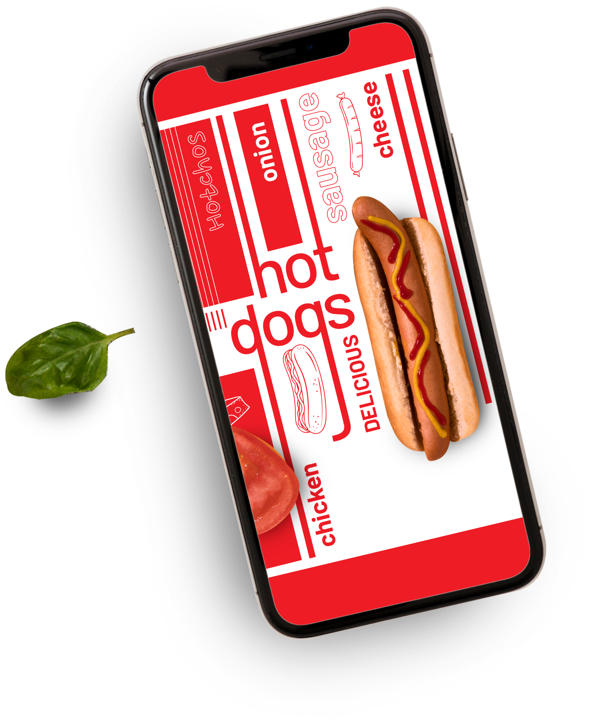





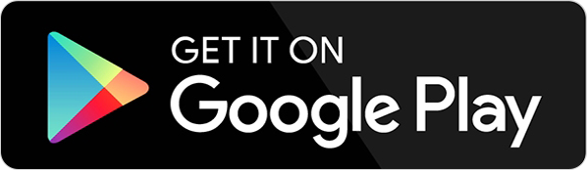
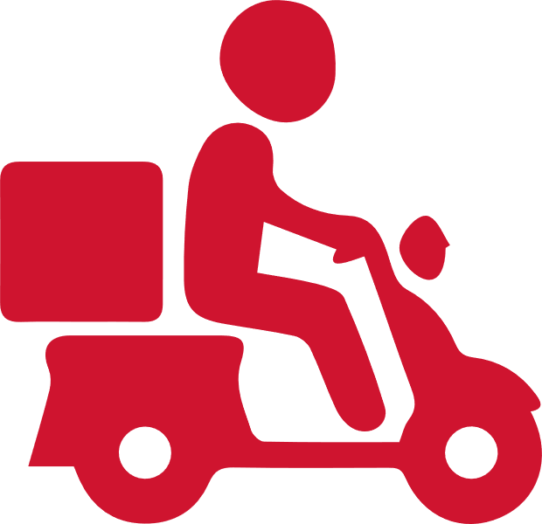
Zomato Data Analysis
Home Delivery

Slide 2
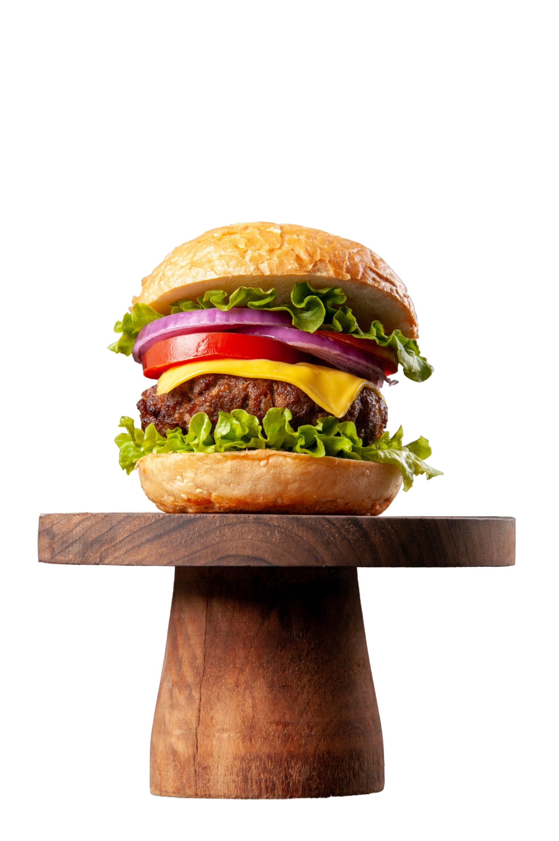
Table Of Contents
01
About Zomato
02
Timeline & Zomato Social Media Following
03
Vision statement and principles & services offered
04
Zomato Competitors, Services & CSR Activities
05
Analysis

Slide 3

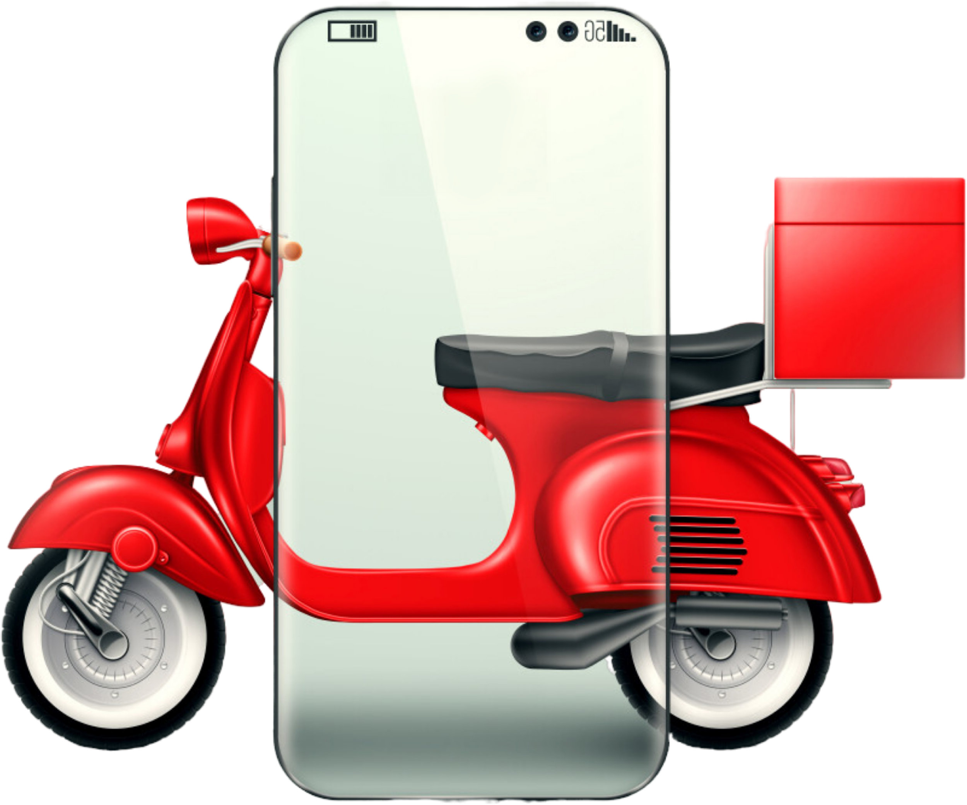

About Zomato
Zomato is an Indian restaurant discovery and food delivery startup founded in 2008. It operates a mobile app that provides information about restaurants such as menus, photos and locations to help users discover new places to eat. Zomato aims to ensure no one has a bad meal by building experiences around dining and enabling restaurants. While it faces threats from competition and regulations, Zomato sees opportunities from expanding globally and increasing smartphone and internet users. Currently operating in over 10,000 cities across 24 countries, Zomato's vision is to help users find great places to eat anywhere in the world.

Slide 4

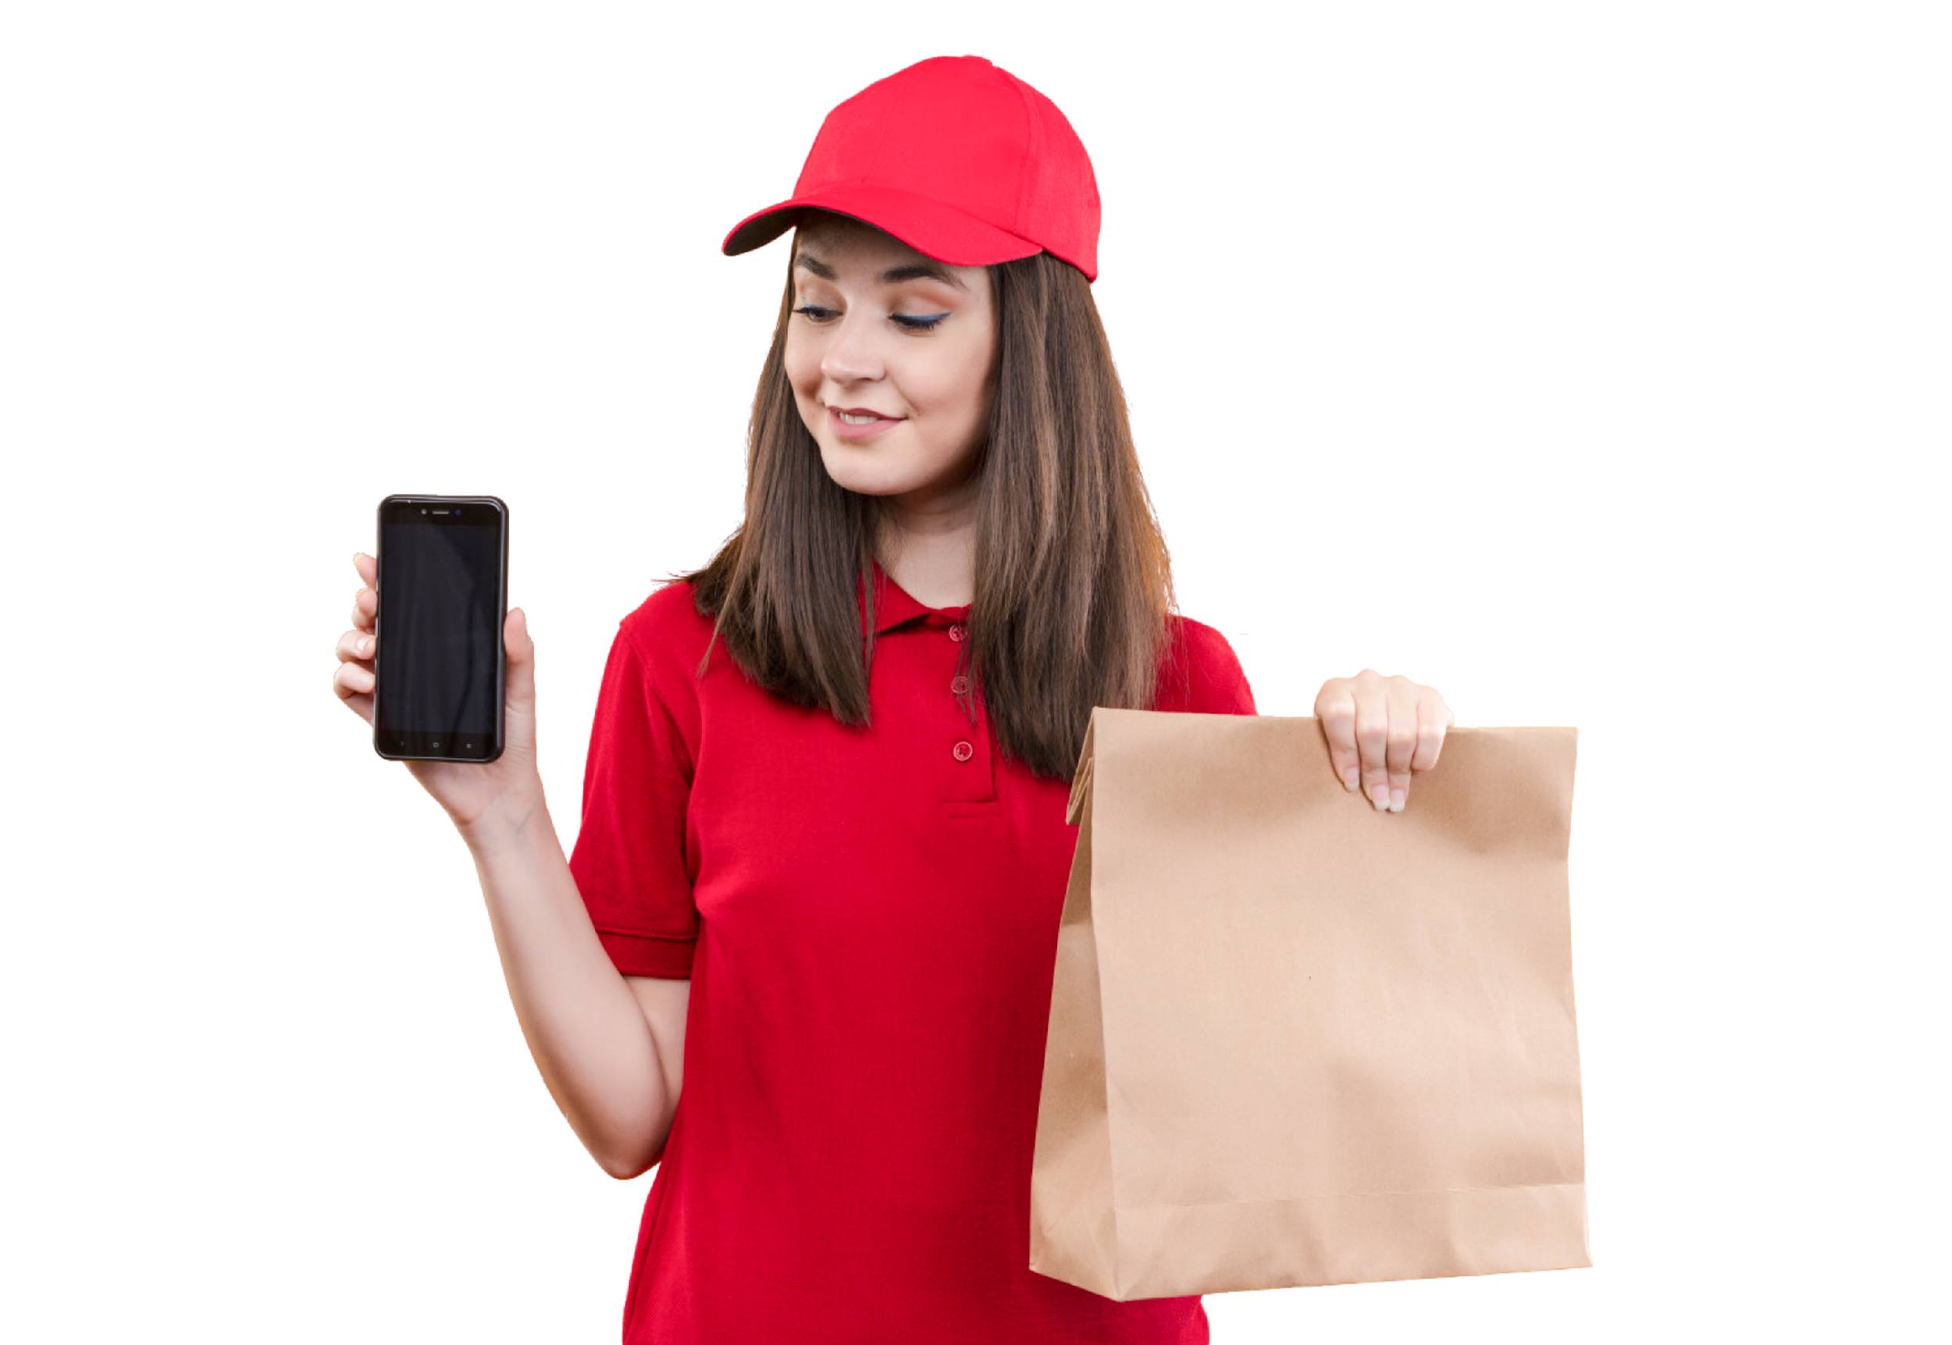
Zomato Company Outline
Started in – July 2008, Delhi
Target Group : All Smartphone Users
Founded By : Deepinder Goyal, Pankaj
Segment : Young Population, working professionals & market research companies
Initial Name : “Foodie Bay”
Renamed as ‘Zomato’ in November 2010
USP – Restaurant & exciting nightlife guild with menus, map locations & pictures
Parent Company : Info edge
Tagline/ Slogan Discover great places to eat around you
Category – Mobile Application Based
Positioning : Zomato provides the ‘Guide’ or the ‘ Discovery’ experience of restaurant & food guide
Sector : Food & Restaurant

Slide 5
Timeline
2008
2010
2012
2013
Launch Foodiebay platform for uploading restaurant menu
Rebranded company as ZOMATO
Company expanded international in Dubai
Raised Capital from Sequoia
2019
2018
2017
2015
- Acquired Hypercure (B2B)
- Winded up international operations
Acquired Hyperlocal delivery platform called Runnr
Launched customer membership program called Zomato Pro
Launched new product Zomato Gold
Launched food delivery ventures in India
Launched restaurant table reservation services
2020
2021
2022
Success Going On….
Acquired UberEATS India
Raised capital from Tiger global and Kora
Acquired Blinkit

Slide 6




Zomato Social Media following
The following slide provides information about the social media following of Zomato across various media platforms such as Facebook, Twitter, Instagram etc

Slide 7

Customer Centric Principles
Zomato’s customer-centric approach revolves around easy accessibility, allowing users to order food or discover restaurants with just a few taps. It emphasizes personalized experiences, using data-driven insights to tailor recommendations and offers. Through transparent reviews, responsive support, and intuitive design, Zomato builds trust and keeps the customer journey seamless.
Accessibility
Quality Assurance
Customer Support
Assortment
Provide access to restaurant food to customer at their doorstep
Provides restaurant ratings and reviews allows customers to determine food quality
Provides top notch customer support
Provides wide range of foods to select from with wide range of services

Slide 8



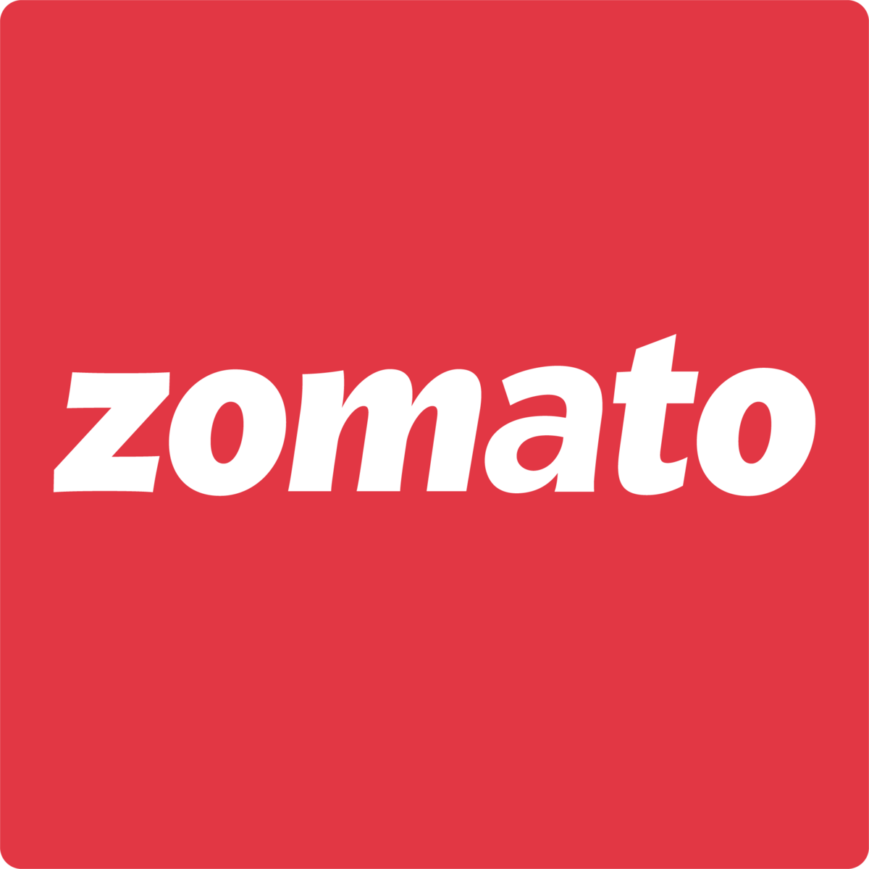






Competitors of Zomato
Here are some popular apps that offer services like Zomato—like food delivery, restaurant discovery, and table reservations
Swiggy
Eat Sure
Dunzo
Eat Fit
Food Panda
Delivery Hero
Door Dash
Just Eat

Slide 9
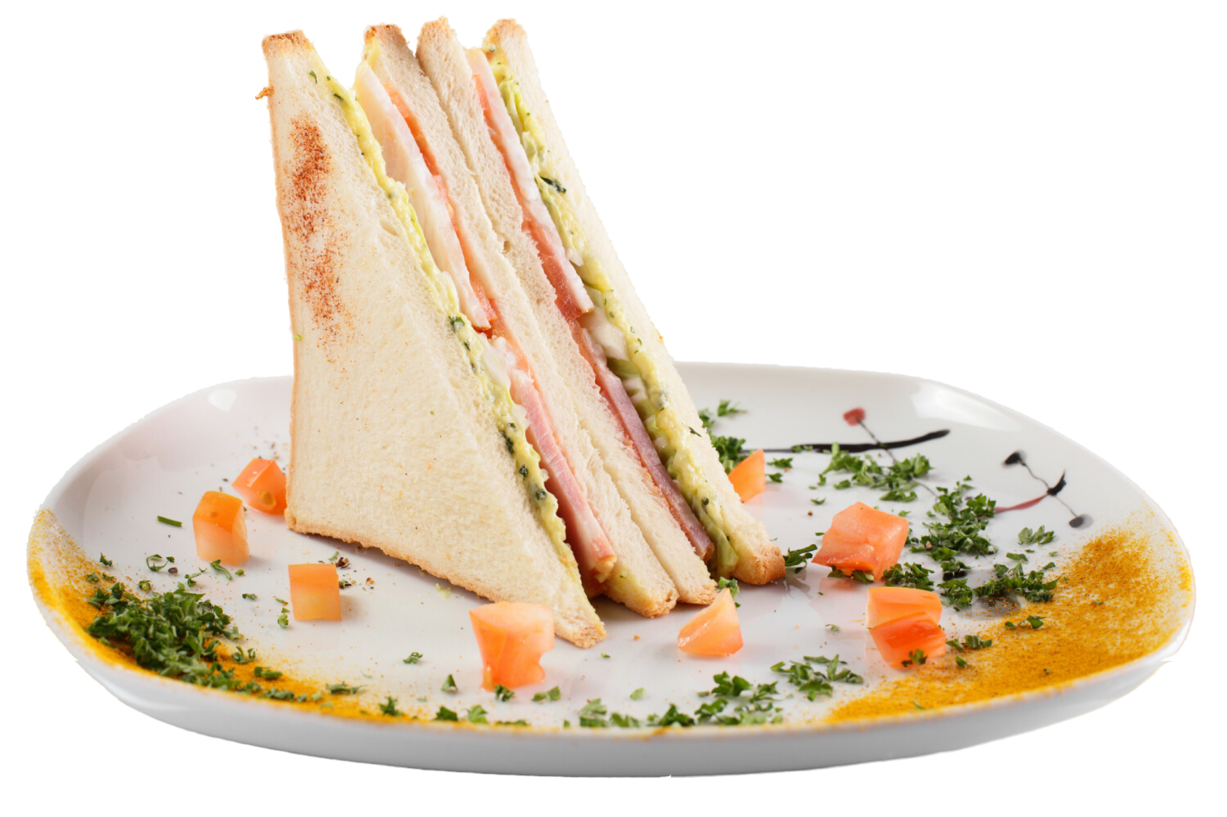
Services Offered
Zomato is a leading food tech platform that offers a wide range of services to enhance the dining experience—from swift food delivery to convenient table reservations. Users can explore restaurants through powerful discovery tools, unlock exciting deals and offers, and access several other features designed to make eating out or ordering in seamless, personalized, and rewarding.
Food Delivery
Table Reservation
Zomato is India’s leading food delivery platform that connects users with thousands of restaurants for quick, reliable doorstep service.
Zomato’s Table booking product called as Zomato District gives users great offers and discounts.
Restaurant Discovery
Deals and offers
It uses smart filters, personalized recommendations, and machine learning to surface the most relevant options—whether you're craving sushi in South Mumbai or budget-friendly biryani in Bandra.
Zomato offers a wide range of discounts, promo codes, and cashback deals to make your food orders more affordable

Slide 10
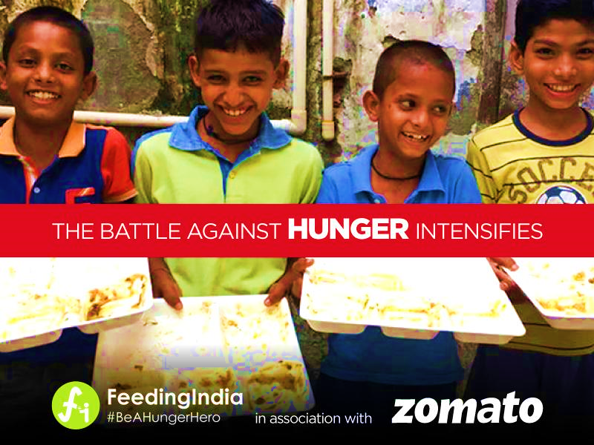
CSR Activities Zomato
Climate Management
Reduced ~92% Scope 3 emission generated from food delivery operation
Reduced ~5% Scope 3 emission generated from purchasing goods and services
Waste-free World
Completely recycled 20000MT of plastic waste in 2023
Launched reusable packaging in selected restaurants in Bengaluru
Zero Hunger
150+ Million meals served since 2014, till date
36+ Million total meals donated by feeding India
Health & Safety
Provide 250K+ road safety assets to delivery partners
set up emergency response ambulance services and helped 380+ delivery partners

Slide 11
SWOT Analysis of Zomato
SWOT analysis is a strategic planning tool used to evaluate the Strengths, Weaknesses, Opportunities, and Threats of a business, project, or individual. It helps organizations understand internal capabilities and external challenges to make informed decisions.
S
Strength
W
Weakness
O
Opportunities
T
Threats
Dependance on single market
High customer acquisition cost
Cybersecurity Risk
Other similar apps
Expand into new markets
Partner with other businesses
Develop new service areas
Intense competition
Technology disruption
Regulatory charges
High Brand Awareness
Global presence
Strong technology platform
Simple and user-friendly app
Large user base

Slide 12
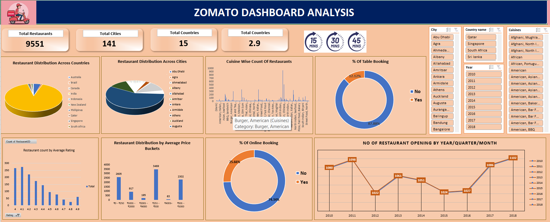
Excel Data Analysis Zomato

Slide 13
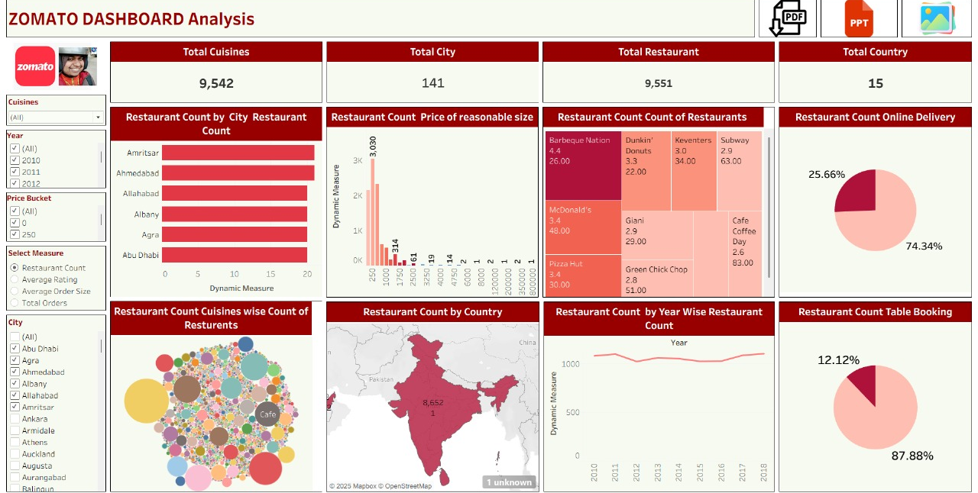
Tableau Data Analysis Zomato

Slide 14
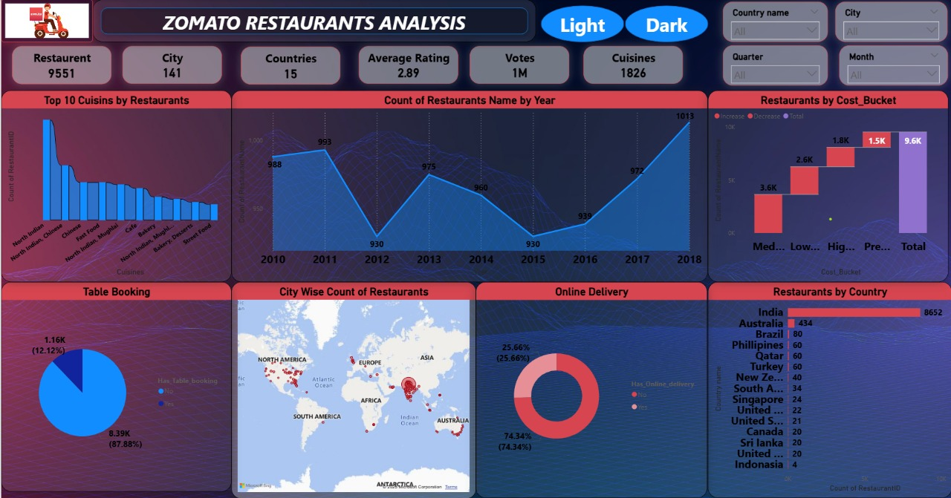
Power BI Data Analysis Zomato

Slide 15
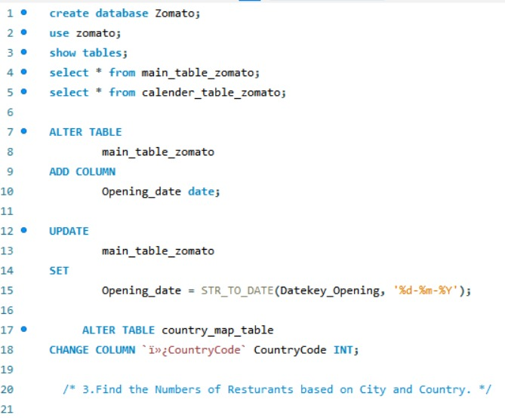
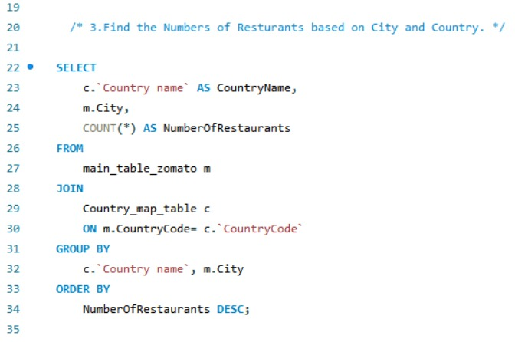
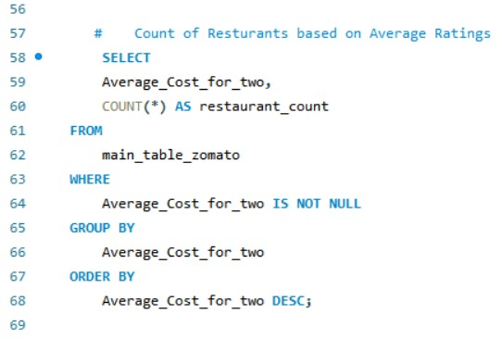
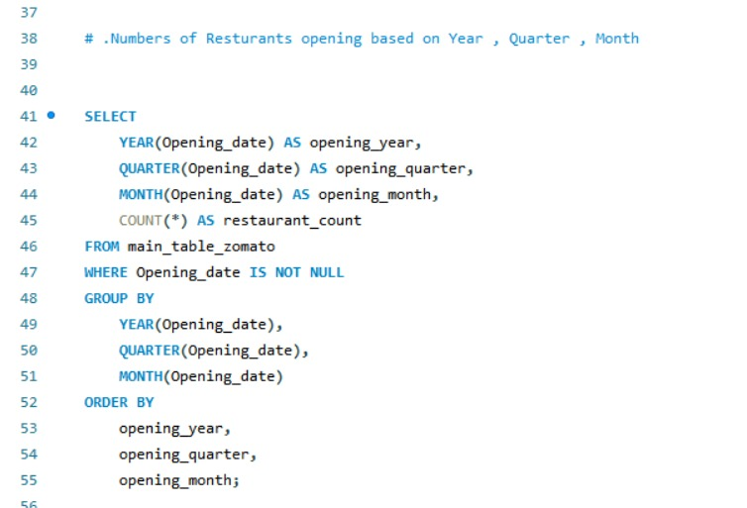
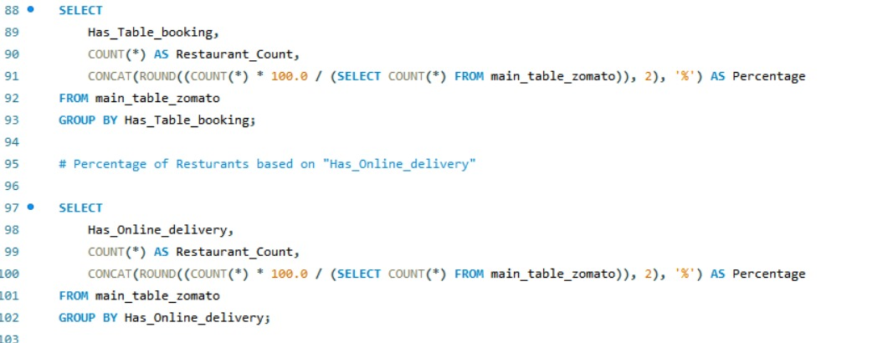
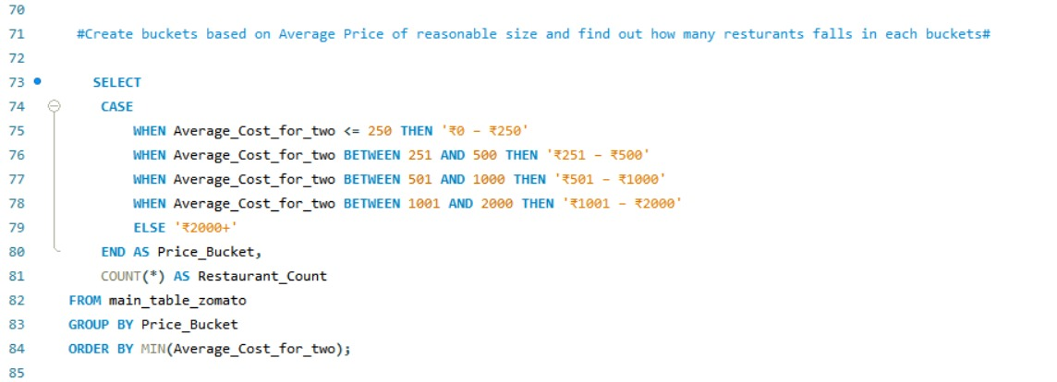
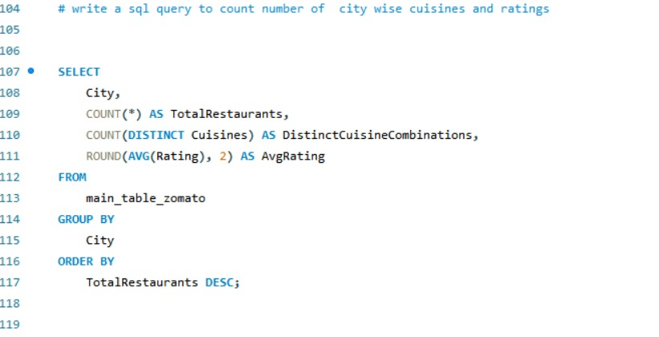

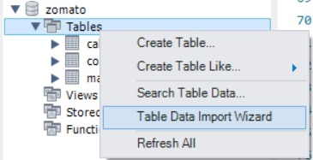
SQL Data Analysis Zomato

Slide 16
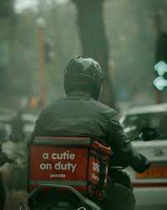
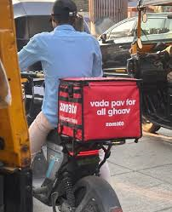
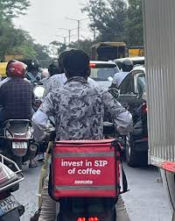
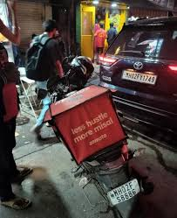
Thank You!

